Slide 1
SMILE: Social Skills Intervention for Students with ASD and EBD
By Rebecca Hartzell
& Kirsten Lansey

Slide 2
The problem…

Slide 3
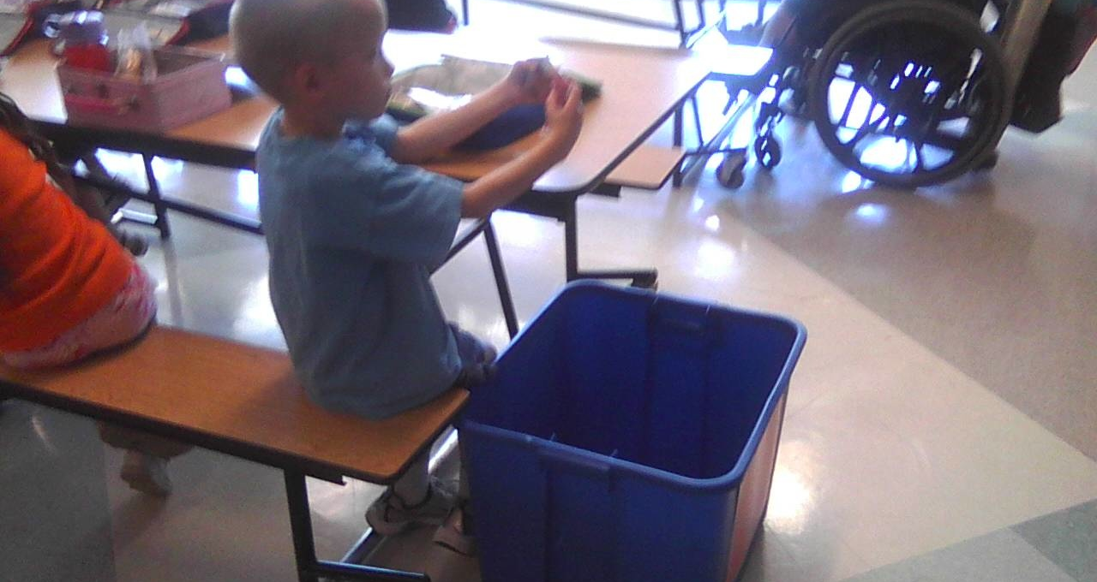
It all started five years ago…

Slide 4
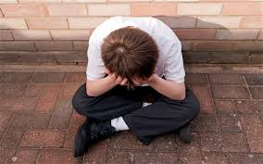
Importance of Social Skills
Delinquent behavior
Depression
Social withdrawal
Poor academic performance
(Cook et al., 2008)

Slide 5
Social Mechanics Integrated in the Learning Environment (SMILE)
SMILE™
Intervention
Prompting procedure
Fading procedure
Brief social skill lessons
(Hartzell, Gann, Liaupsin, & Clem, 2015)

Slide 6
Purpose
Effects of SMILE intervention on the social engagement of two seventh grade students with Emotional Behavioral Disorder and three eighth grade students with Autism Spectrum Disorder with typically developing peers.

Slide 7
Participant Selection
Teacher identification
Past social isolation and/or difficulty
Below average Social Skills domain score on Social Skills Improvement System (SSIS)

Slide 8
Nathan
Social Skills Improvement System |  | Score
Social Skills | Standard Score | 89
 | Percentile Rank | 25
Problem Behavior | Standard Score | 124
 | Percentile Rank | 90
7th grade
Caucasian
EBD
Isolated from peers
Avoided by peers
“I don’t think it will work”

Slide 9
Jonathan
Social Skills Improvement System |  | Score
Social Skills | Standard Score | 86
 | Percentile Rank | 18
Problem Behavior | Standard Score | 123
 | Percentile Rank | 89
7th grade
Hispanic
EBD
Inappropriate during social interactions
Physical with peers

Slide 10
Layla
Social Skills Improvement System |  | Score
Social Skills | Standard Score | 89
 | Percentile Rank | 21
Problem Behavior | Standard Score | 105
 | Percentile Rank | 66
8th grade
Caucasian
ASD
Withdrawn
Black hoodie
Isolated

Slide 11
Thomas
Social Skills Improvement System |  | Score
Social Skills | Standard Score | 78
 | Percentile Rank | 9
Problem Behavior | Standard Score | 160
 | Percentile Rank | 99
8th grade
African American
Spends only half of day in general education classroom
Inappropriate with peers
Impulsivity

Slide 12
Kade
Social Skills Improvement System |  | Score
Social Skills | Standard Score | 81
 | Percentile Rank | 12
Problem Behavior | Standard Score | 128
 | Percentile Rank | 95
8th grade
Asian
ASD
One class in general education setting
Withdrawn
Avoids social interaction

Slide 13
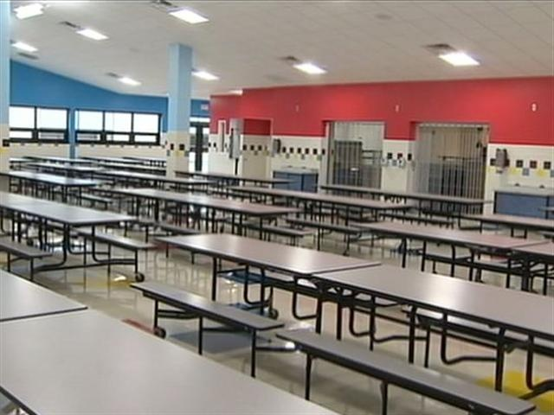
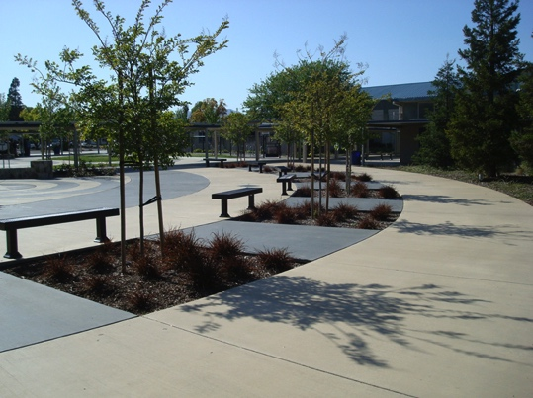
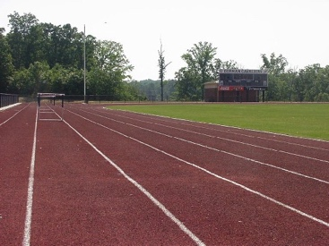
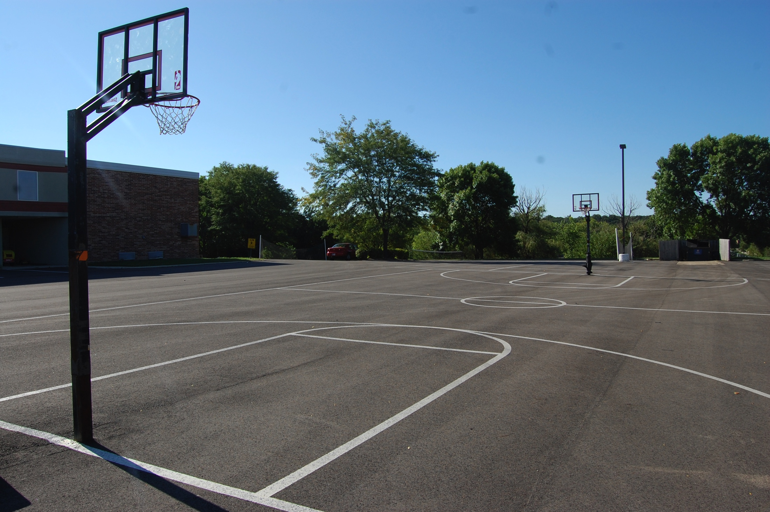
Setting
Lunchroom
Track
Courtyard
Basketball Court / Field

Slide 14
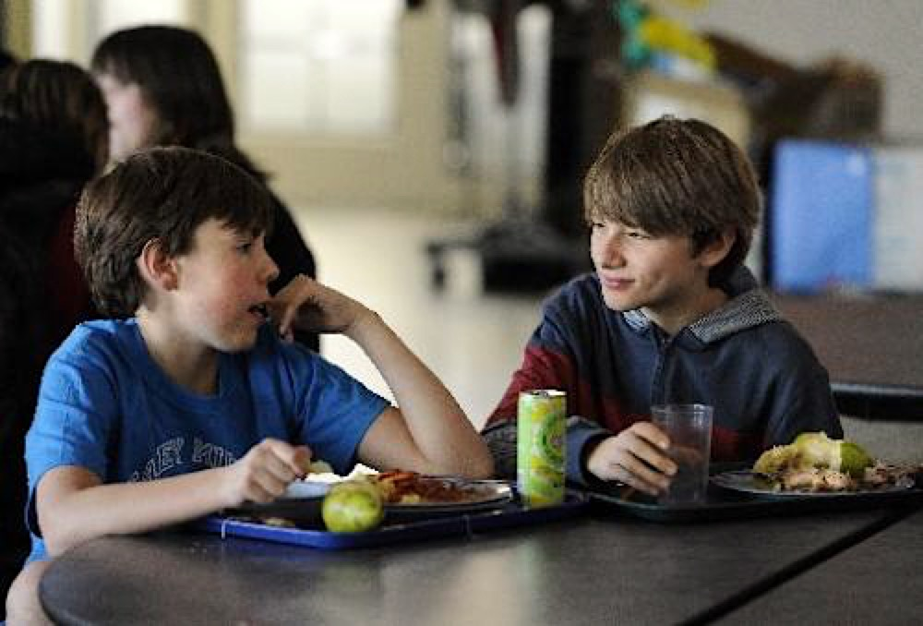
Dependent Variable
Appropriate Social Engagement
Verbal interaction
Listening to peer
Facing peer / eye contact
Leaning into peer
Nodding, smiling, laughing
With typically developing peers

Slide 15
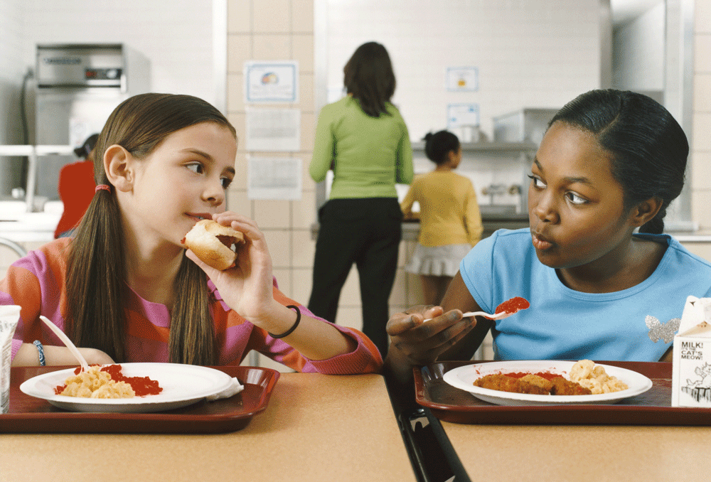
Independent Variable
SMILE Intervention
Adult-mediated in personal “check-ins” with participants /peers
Student Specific
Peer Prompting

Slide 16
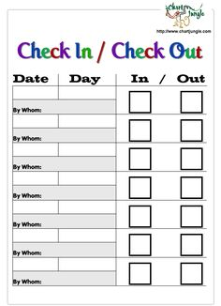
Adult-Mediated “Check-ins”
1-2 weekly
Individual
Participants / Peers
Troubleshoot problems
Make goals

Slide 17
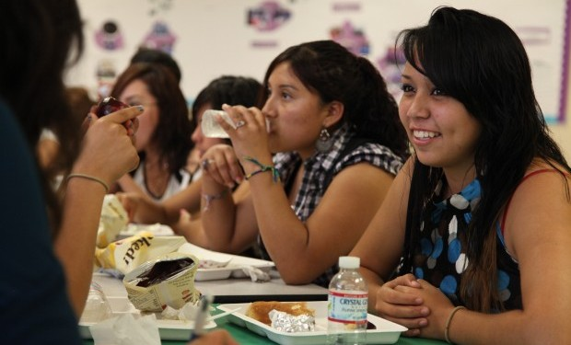
Student Specific
Each participant had different goals
Peers prompted students based on current interactions

Slide 18
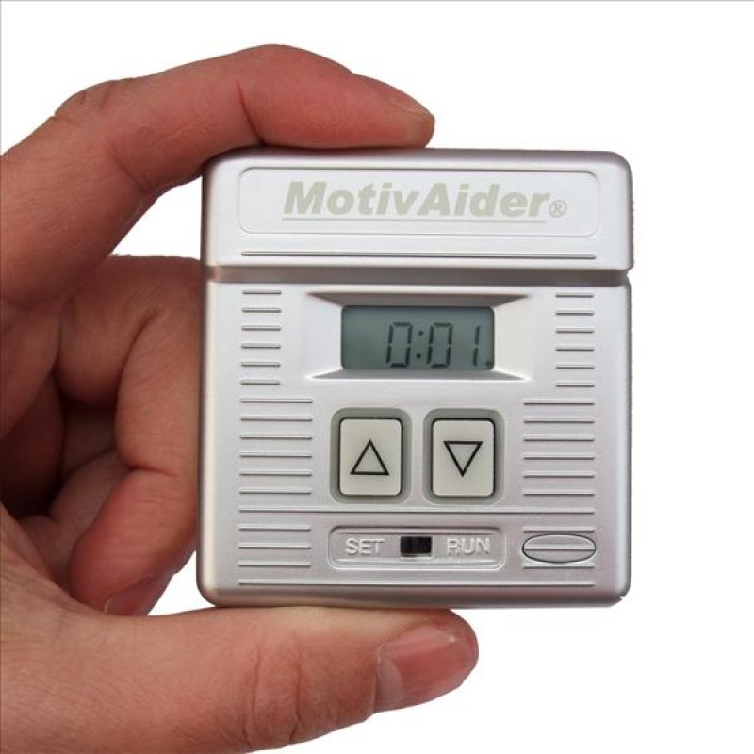
Peer Prompting
1 Prompt each minute
Students wore MotivAider to remind each minute

Slide 19
Reinforcement
Peers received one movie ticket each week for participation in peer prompting

Slide 20
Method
Design
Data Collection
Multiple probe design
Phases
Baseline – ABC data
Intervention
Maintenance
20 minute sessions
15-second momentary time sampling
Social engagement

Slide 21
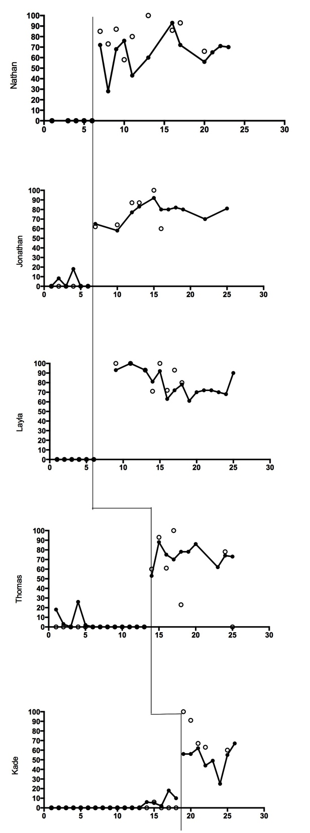
Results

Slide 22
Results
Student | Phase | Engagement | Range
Nathan | Baseline | 0 | 0
 | Intervention | 64 | 28-93
Jonathan | Baseline | 4.38 | 8.3-18.0
 | Intervention | 77.1 | 58-92
Layla | Baseline | 0 | 0
 | Intervention | 78.3 | 61-100
Thomas | Baseline | 0 | 0
 | Intervention | 73 | 53-86
Kade | Baseline | 8.2 | 6-18
 | Intervention | 51.8 | 25-67

Slide 23
Generalization
Across Participants
Across Settings
Movie Theater
Friend’s House (horseback riding)
Skate Park
Across Social Behaviors
Twitter
Instagram
Texting

Slide 24
Reliability
Participants | Treatment Integrity | IOA
Nathan | 76.67 | 96.71
Jonathan | 80.1 | 92.88
Layla | 88.63 | 95.5
Thomas | 69.17 | 99.2
Kade | 76.2 | 94

Slide 25
Post Interviews: Peers
“It helps my social skills”
“Gives you that experience when you go out and get a job, and be able to talk to people.”
“Are you doing it next year? It was pretty fun.”
“I was looking forward to helping out these kids become more social and better friends with other people and actually give them the opportunity.”
“It’s not like there was a demand that we had to, it’s not like we were forced to, it’s that we chose to give our time to be with them.”
“And it wasn’t that hard either, all we had to do was sit by them and talk to them.”

Slide 26
Post Interviews: Peers
“We weren’t, like giving up anything because our friends were already sitting there so it’s just like adding two more people to our group.”
“I got a new friend out of it.”
“I mean a lot of people are great, but there are some teachers that I have a hard time with, they are so negative. If we were a lot more, like positive energy, I feel like it would be easier for them. They would feel more welcomed.”
“Right now, school is not a welcoming place for him.”
“I liked that I got to see (student) open up, and now he makes jokes in class. Like he laughs and stuff, he’s involved now.”

Slide 27
Post Interviews: Participants
“I like how I got to meet different people, and meet other people because of those people.”
“I liked that I got to spend my lunch doing something else.”
“I liked eating lunch in the cafeteria.”
“I liked sitting with the boys. It was fun.”
“I like it. Cause I can actually express my ideas to someone.”

Slide 28
Post Interviews: Participants
“I do like to branch out sometimes.”
“It was pretty nice, I could see all my friends.”
“Over here you could listen to music, and eat, and talk to your friends still, and play games like football, baseball, oh I hit a homerun!”
“I met a lot of people”
“I like to eat lunch with (peer mediators) because they were really nice.”
“It was worse. Because I didn’t have nobody to hang out with.”

Slide 29
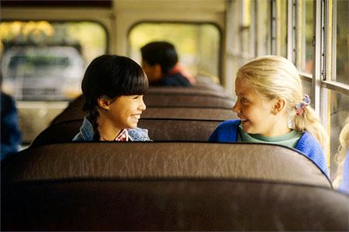
Limitations
9 weeks of intervention
Not all students were in general education setting
Lack of generalization data

Slide 30
Future Research
Structured lessons for participants
Structured training for peer mediators
Extended intervention period
Generalization measurements

Slide 31
Parent Responses
I am [peer mediator’s] mom. I just wanted to let you know how much I loved your project! [Peer mediator] has changed as a child, as a friend, and as a student. She was so excited to see her when she could. [Peer mediator] has said she wants to be a teacher for a long time, but this has really solidified that she wants to be a special education teacher. [Peer mediator] has told me that this little girl has really come out of her shell and she’s so proud of that.
I want to thank you for helping us, as parents, continue the growth of our daughters character away from home. This has not only had an affect on the student she got to hang out with, it also helped her grow into a more kind, well-rounded, accepting young woman. There is great strength in acceptance and nurturing this is beyond measure.

Slide 32
Questions
Kirsten Lansey- klansey@email.arizona.edu
Rebecca Hartzell-hartzell@email.arizona.edu

