Slide 1
SMILE Intervention: Social Mechanics Integrated in the Learning Environment
By Rebecca Hartzell, MA
& Candace Gann, Phd

Slide 2
It all started five years ago…

Slide 3
Social Deficits:
Autism Spectrum Disorder
Emotional Behavioral Disorder
Attention Deficit Disorder
Learning Disabilities

Slide 4
Intervention needed
Skills deficit
Performance deficits
Natural Environment
Lack of generalization

Slide 5
2+2=5
Complexity of social behavior
Different generalization effect as academic skills
History of learner with his peers
Learner’s social deficits
Functional assessment of social difficulty
(Scott & Nelson, 1998)

Slide 6
Social Mechanics Integrated in the Learning Environment (SMILE)
SMILE™
Intervention
Brief social skill lessons
Prompting/Fading procedure
Peer Involvement
(Hartzell, Gann, Liaupsin, & Clem, 2015)

Slide 7
Participant Selection
Diagnosed with autism by multidisciplinary team.
Identified by teacher as displaying social skills deficits.
Below average Social Skills domain score on SSIS

Slide 8
Participant: Mary
8 years old
Down Syndrome
Avoid social interactions
Aggressive social behaviors
Speech difficulty
Standard score of 79 on SSRS social skills subscale

Slide 9
Participant: Chantelle
7 years old
Process of evaluation for ASD
Avoided contact with peers
Limited social contact
Low audibility
Standard score of 67 on SSRS social skills subscale

Slide 10
Participant: Beatrice
7 years old
ASD
Often attempted to socialize
Often aggressive
Wanderer
Standard score of 64 on SSRS social skills subscale

Slide 11
Setting
Treatment
Generalization

Slide 12
Lessons
Direct Instruction
5-10 minutes delivered before lunch
Review
Presentation
Guided Practice
Correction & Feedback
Independent Practice

Slide 13
Example of Lesson
5-10 minutes in length

Slide 14
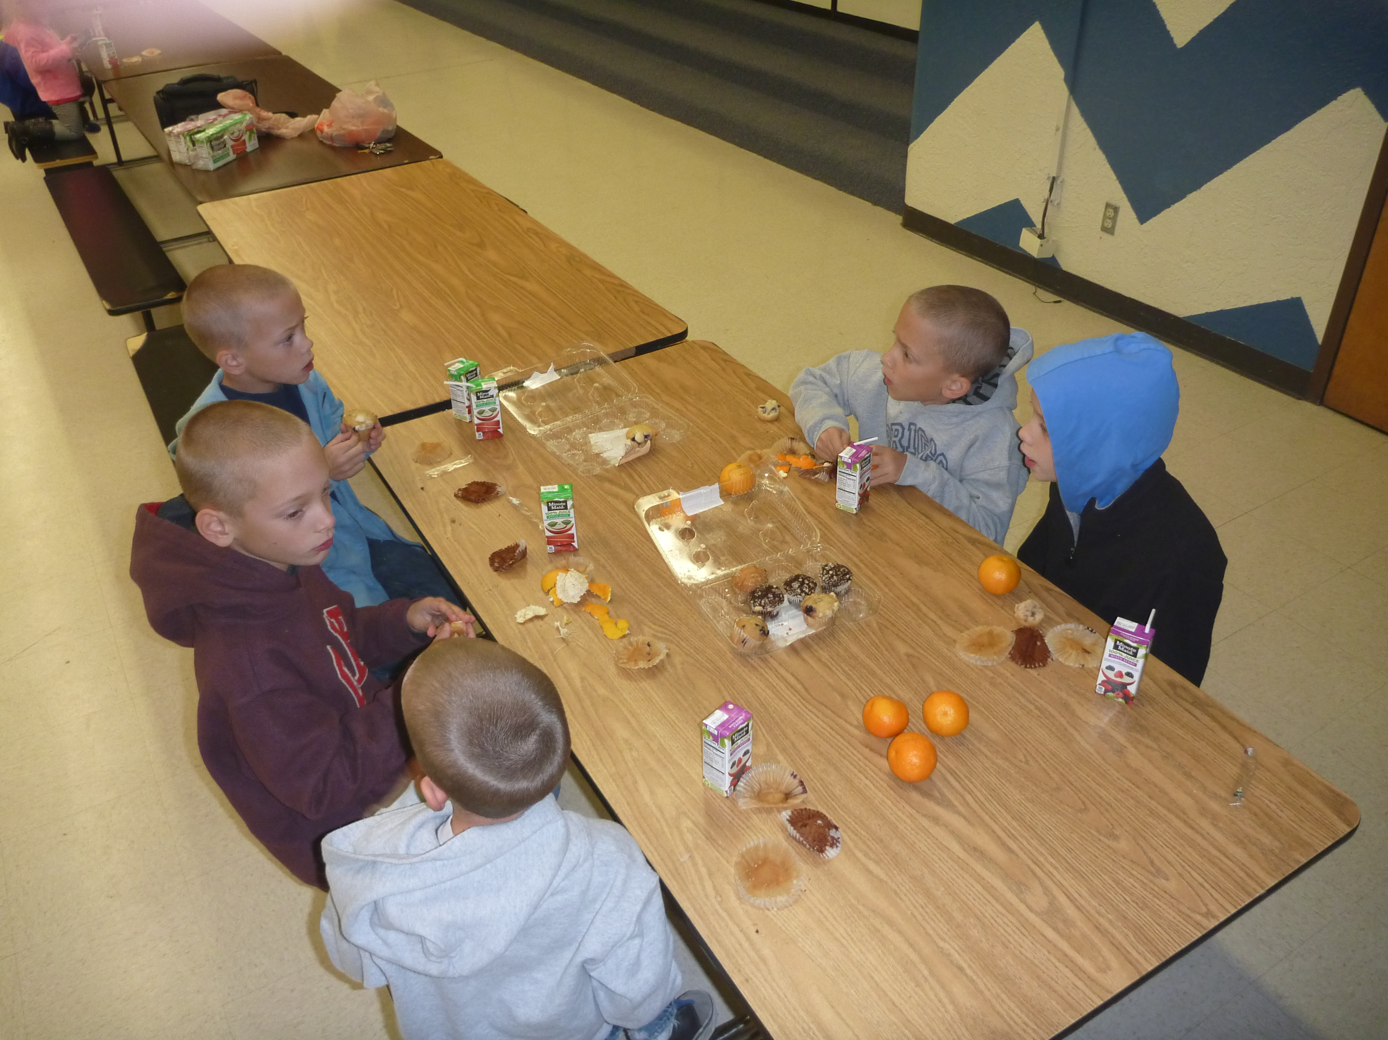
Prompting Procedure
Instructor verbally prompts social skill in one-minute intervals
Give eye contact to friend
Face peer
Use an audible voice
Generic conversation starter
Ask your friend what they did last night.
Ask your friend what they did over the weekend.
Ask your friend what they have for lunch today.
Contribute to ongoing conversation

Slide 15
Reinforcement
First fade – friend paper
Second fade – reinforce peer
Third fade – verbal praise
Final fade – no reinforcement

Slide 16
Peer Involvement
History of learner with peer
Friend paper
Participant delivered reinforcement
(Scott & Nelson, 1998)

Slide 17
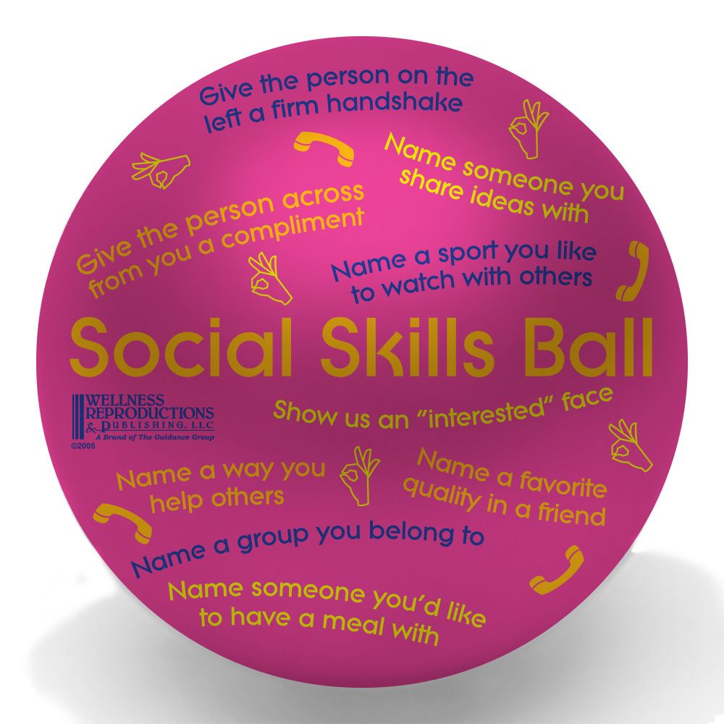
Fading Procedure
Fading begins when student is able to maintain social engagement levels at or above 60% of session intervals over five sessions (Hartzell, Gann, Liaupsin, & Clem, 2015)
Prompts faded to one prompt per every 2 minutes
Student no longer receives stickers for talking at lunch from peer
Peers now receive sticker from student for being a good friend
Prompts faded to one prompt per every 4 minutes
Prompts discontinued, but student receives occasional praise from adults for appropriate social behavior at lunch

Slide 18
Example of SMILE

Slide 19
Social Engagement
Autism Spectrum Disorder
 | M | C | B
 | Baseline
Avg. | 1% | 2% | 1%
Rng. | 0-2% | 0-7% | 0-3%
 | Intervention
Avg | 62% | 73% | 36%
Rng. | 20-93% | 50-97% | 17-72%
TI | 98% | 98% | 98%
 | Fading
P 2m | 70% | 81% | NA
P 4m | NA | 66% | NA
P -- | NA | 69% | NA
 | Maintenance
Avg. | 47% | 50% | 25%
Rng. | 30-68% | 40-62% | 16-37%
86
88
123
125
127

Slide 20
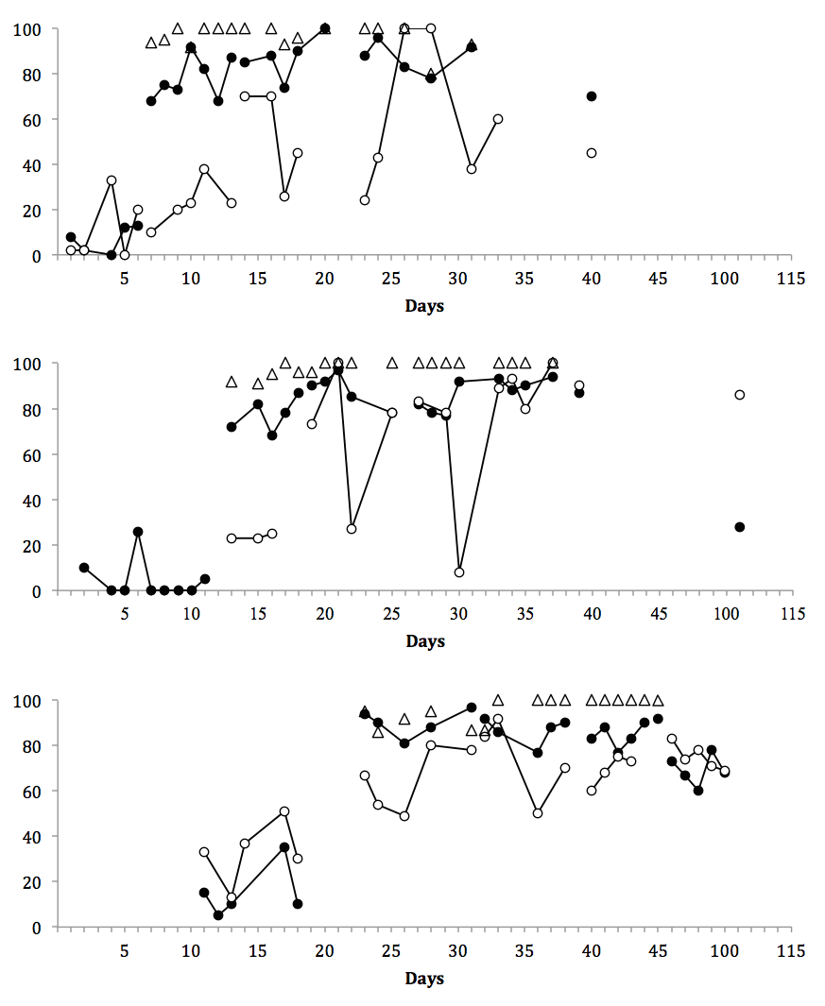
Emotional Behavioral Disorder
Baseline
2 min
Intervention
Maintenance
1 min
4 min
Phase | Setting
 | Lunchroom | Playground
Baseline | 7% | 11%
Intervention | 83% | 37%
Maintenance | 28%* | 86%*
=
Dayton
SSIS Standard Score | Pre- | Post
Social Skills Index | 74 | 84
Phase | Setting
 | Lunchroom | Playground
Baseline | 5% | NA
Intervention | 85% | 63%
Maintenance | NA | NA
Percent of Intervals Socially Engaged
=
Nathan
SSIS Standard Score | Pre- | Post
Social Skills Index | 67 | 72
Phase | Setting
 | Lunchroom | Playground
Baseline | 15% | 34%
Intervention | 87% | 69%
Maintenance | 69%* | 75%*
=
Lucas
SSIS Standard Score | Pre- | Post
Social Skills Index | 67 | 90
Notes:
Candace

Slide 21
Anecdotal effects
Behavior
2+ years later
Increased time in gen ed classroom
Improved academic achievement

Slide 22
Troubleshooting
Staffing
Data
Lunchroom atmosphere
Focus on social skills
Inclusion

Slide 23
Middle School
NOW
Lessons – Adult
1-2 times per week
Prompting – Peer mediator
3 times weekly

Slide 24
Participant: Layla
13 years old
Diagnosed with ASD
Quiet
Head down, black hoodie every day
Ate lunch for 5-7 minutes each day
Stood by bathrooms

Slide 25
Participant: thomas
14 years old
Diagnosed with ASD and ADD
Inappropriate with peers
Touched girls and boys inappropriately
Roamed around lunchroom looking for food

Slide 26
Participant: Kade
14 years old
Diagnosed with ASD
Quiet
Awkward with peers
Ate lunch in SPED room every day

Slide 27
hartzell@email.arizona.edu
Candace.gann@utsa.edu

