Slide 1
Social Engagement with Generalization for Students with EBD
Rebecca Hartzell, MA
Candace Gann, PhD
Carl Liaupsin, PhD

Slide 2
Social Skills
Social Skills may be defined as socially acceptable behavior that “enable a person to interact with others in ways that elicit positive responses and assist in avoiding negative responses.”
(Elliot & Gresham, 1993)

Slide 3
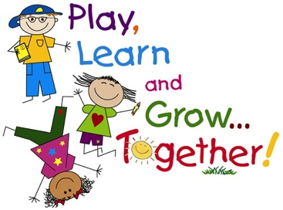
Social Skills with EBD…
10 times more likely to have social deficits as compared to students with other high-incidence disabilities
School failure and dropout
Arrest, substance abuse, suicide
Academic failure
Poor self-regulation
12.5 times more likely to be suspended
(Duran et al., 2013, Wagner et al., 2005, Malecki & Elliot, 2002; Meier et al., 2006, Davis & Vander, 1997; Malmgren et al., 1998; Unger, 1995)

Slide 4
Social Skills Instruction and EBD
Video modeling
Video feedback
Self-evaluation
Reinforcement
Role-playing
Self-monitoring
Peer training
Modeling
(Blood et al., 2011; Hansen & Linugaris/Kraft, 2005; Kern et al., 1995; Kern et al., 2007; Kern-Dunlap et al., 1992; Moore et al., 1995; Presley & Hughes, 2000)

Slide 5
Generalization
Social Skills Intervention (SSI) improve social behavior of 65% of students with EBD, but generalization results have continued to be a challenge for researchers.
Planning for generalization in SSI stressed for this population.
(Terrance & Nelson, 1988; Mathur & Rurtherford, 1996; Mathur & Rutherford, 1991; Gresham, 2015; Gresham, 1997; Gresham, Sugai and Horner, 2001; Baer, Wolf, & Risley 1968)

Slide 6
2+2=5
Complexity of social behavior
Different generalization effect as academic skills
History of learner with his peers
Learner’s social deficits
Functional assessment of social difficulty
(Scott & Nelson, 1998)

Slide 7
Social Mechanics Integrated in the Learning Environment (SMILE)
SMILE™
Intervention
Brief social skill lessons
Prompting procedure
Fading procedure
(Hartzell, Gann, Liaupsin, & Clem, 2015)

Slide 8
Purpose
Effects, generalization and maintenance of intervention employing brief social lessons with a prompting/fading procedure for social engagement in the natural, integrated lunchroom setting for three elementary age students with emotional behavior disorder (EBD).

Slide 9
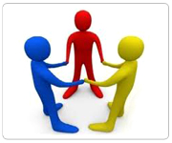
Participant Selection
Teacher identification
Displays chronic social interaction deficits
Past requests of additional social supports
Involvement in past social skills interventions in the past with little to no success
Below average Social Skills domain score on SSIS

Slide 10
Participants
Social Skills Improvement System |  | Score
Social Skills | Standard Score | 74
 | Percentile Rank | 5
Problem Behavior | Standard Score | 115
 | Percentile Rank | 82
Academic Competence | Standard Score | 99
 | Percentile Rank | 51
Dayton
8 years old
EBD
Difficulty maintaining social interactions
Inappropriate during social interactions
Avoided by peers
Exaggerates

Slide 11
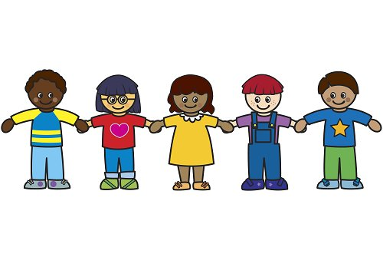
Social Skills Improvement System |  | Score
Social Skills | Standard Score | 67
 | Percentile Rank | 2
Problem Behavior | Standard Score | 155
 | Percentile Rank | >99
Academic Competence | Standard Score | 68
 | Percentile Rank | 2
Nathan
9 years old
EBD
Slow speech
Physically awkward
Learning difficulties in all areas
Not allowed to attend lunch/recess due to physical aggression toward peers

Slide 12
Social Skills Improvement System |  | Score
Social Skills | Standard Score | 67
 | Percentile Rank | 2
Problem Behavior | Standard Score | 75
 | Percentile Rank | 6
Academic Competence | Standard Score | 73
 | Percentile Rank | 5
Lucas
8 years old
EBD
Severe learning difficulties in reading/writing
Inappropriate with peers
Talks loudly
Chases and hits peers during recess

Slide 13
Setting
Treatment
Generalization

Slide 14
Variables
Dependent
Appropriate Social Engagement
Verbal interaction
Listening to peer
Facing peer
Appropriate body language
Audibility
Independent
SMILE Intervention
Social skills lessons
Prompting
1 minute intervals
Fading
4 days at 50% or higher

Slide 15
Design and Data Collection
Multiple probe design
Phases
Baseline
Intervention
Maintenance
Beginning of fall semester
Generalization
Playground
Data collection
20 minute sessions
15-second momentary time sampling for social engagement
IOA
Social Engagement
Treatment Integrity

Slide 16
Reliability

Slide 17
Lessons
Direct Instruction
Review
Presentation
Guided Practice
Correction & Feedback
Independent Practice

Slide 18
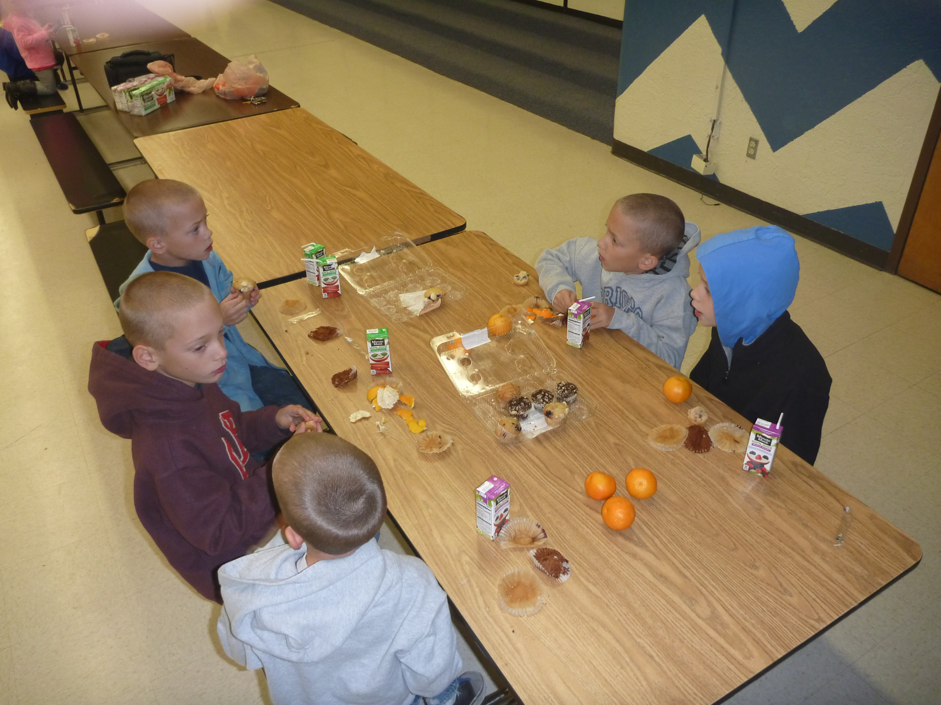
Prompting Procedure
Instructor verbally prompts social skill in one-minute intervals
Give eye contact to friend
Face peer
Use an audible voice
Generic conversation starter
Ask your friend what they did last night.
Ask your friend what they did over the weekend.
Ask your friend what they have for lunch today.
Contribute to ongoing conversation

Slide 19
Reinforcement
First fade – friend paper
Second fade – reinforce peer
Third fade – verbal praise
Final fade – no reinforcement

Slide 20
Peer Involvement
History of learner with peer
Friend paper
Participant delivered reinforcement
(Scott & Nelson, 1998)

Slide 21
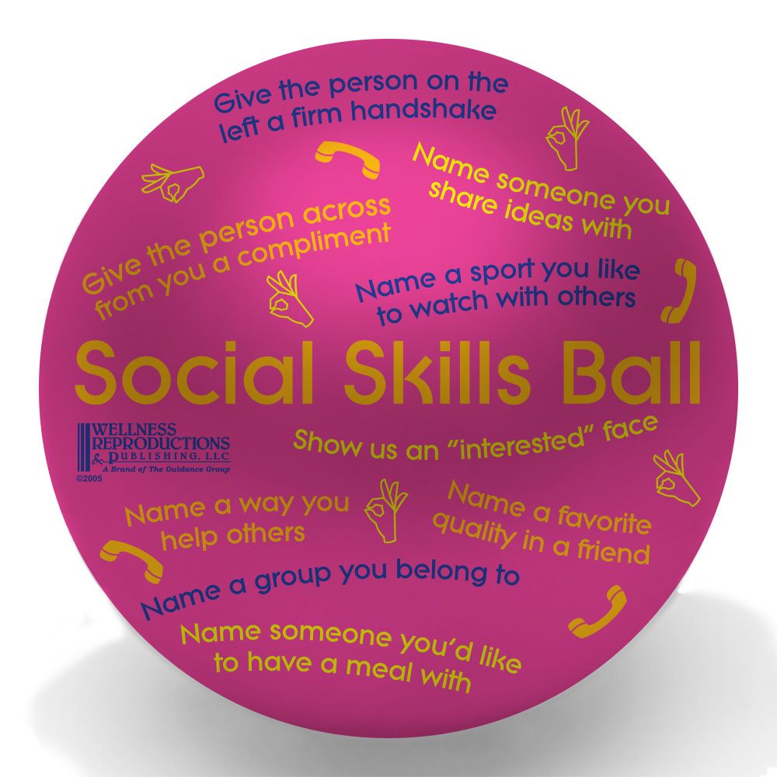
Fading Procedure
Fading begins when student is able to maintain social engagement levels at or above 60% of session intervals over five sessions
Prompts faded to one prompt per every 2 minutes
Student no longer receives stickers for talking at lunch from peer
Peers now receive sticker from student for being a good friend
Prompts faded to one prompt per every 4 minutes
Prompts discontinued, but student receives occasional praise from adults for appropriate social behavior at lunch

Slide 22
Results

Slide 23
Summary
Results support use of SMILE Project with students with EBD
Results show skills generalize to novel settings
Social validity results show intervention to be effective.

Slide 24
Limitations
Lack of classroom data
Maintenance results
Absences

Slide 25
Future Research
Effect on problem behavior
Effect with older students
Paraprofessional training
School culture

Slide 26
If civilization is to survive, we must cultivate the science of human relationships – the ability of all peoples, of all kinds, to live together, in the same world at peace.
-Franklin D. Roosevelt

Slide 27
References
Blood, E., Johnson, J., Ridenour, L., Simmons, K., & Couch, S. (2011). Using an iPod touch to teach social and self-management skills to an elementary student with emotional/behavioral disorders. Education and Treatment of Children, 34(2), 299-317.
Hansen, S. D., & Linugaris/Kraft, B. (2005). Effects of a dependent group contingency on the verbal interactions of middle school students with emotional disturbance. Behavioral Disorders, 30, 170–184.
Kern, L., Starosta, K. M., Cook, C. R., Bambara, L. M., & Gresham, F. R. (2007). Func- tional assessment-based intervention for selective mutism. Behavioral Disorders, 32, 94–108.
Kern, L., Wacker, D. P., Mace, F. C., Falk, G. D., Dunlap, G., & Kromrey, J. D. (1995). Improving the peer interactions of students with emotional and behavioral disorders through self-evaluation procedures: A component anal- ysis and group application. Journal of Applied Behavior Analysis, 28, 47–59. doi:10.1901/jaba.1995.28-47
Kern-Dunlap, L., Dunlap, G., Clarke, S., Childs, K. E., White, R. L., & Stewart, M. P. (1992). Effects of a videotape feedback package on the peer interactions of children with serious behavioral and emotional challenges. Journal of Applied Behavior Analysis, 25, 355–364. doi:10.1901/jaba.1992.25-355
Moore, R. J., Cartledge, G., & Heckaman, K. (1995). The effects of social skill instruction and self-monitoring on game-related behaviors of adolescents with emotional or behavioral disorders. Behavioral Disorders, 20, 253–266.
Presley, J. A., & Hughes, C. (2000). Peers as teachers of anger management to high school students with behavioral disorders. Behavioral Disorders, 25, 114–130.
Baer, D. M., Wolf, M. M., & Risley, T. R. (1968). Some current dimensions of applied behavior analysis. Journal of Applied Behavior Analysis, 1, 91–97.

