Slide 1
Social Skills Learned in Unexpected Places: An Approach for Students with EBD
Candace Gann, PhD
University of Texas at San Antonio
Candace.gann@utsa.edu
Rebecca Hartzell, MA
University of Arizona
Hartzell@email.arizona.edu

Slide 2
Social skills
“enable a person to interact with others in ways that elicit positive responses and assist in avoiding negative responses.”
(Elliott & Gresham, 1993, p. 33)

Slide 3
Social Skills Deficits and EBD
10 times more likely to have social skills deficits as compared to other high-incidence disabilities (Duran et al., 2013; Lane et al., 2006)
Those with poor social skills 12.5 times more likely to be suspended than students with better social skills (Duran et al., 2013)
Social deficits linked to school failure and dropout, academic difficulties, and poor self-regulation (Daunic et al., 2013; Malecki & Elliott, 2002; Wagner et al., 2005)
Post secondary outcomes may include high school dropout, substance abuse, incarceration, mental disorders, and suicide (Malmgren et al., 1998)

Slide 4
Social Skills Instruction and EBD
Teacher struggles with social skills instruction within time and resource constraints of schools (Battalio & Stephens, 2005)
Social skills minutes are not always met (Battalio & Stephens, 2005)
Lack of generalization of skills to new peers (Mathur et al., 1998; Sigman & Ruskin, 1999)
Notes:
In many cases, special and general education teachers struggle with how to support the development of desirable social skills within the time and resource constraints of day-to-day instruction. Teachers struggle to find approaches that will really work and are feasible given their current conditions and constraints that may be present within the school context, such as teacher skills, resources, and time.
In a survey of teachers, 38% of special elementary teachers reported that they delivered some sort of social skills instruction 2-3 times per week. The same number of teachers, however, reported that they provided social skills instruction one time per week or not at all. Further, delivery of social skills instruction was reactive rather than proactive and implemented in self-contained classrooms – meaning students with EBD are learning to interact with students with similar deficits rather than with typically developing peers who could potentially model more sophisticated social skills.
According to Mathur and colleagues, while 60% of students with EBD have shown improvements in social skills across studies, generalization results were limited. In this same survey, facilitating generalization of skills to the inclusive environment was one of the areas teachers struggled with most. In fact, 62% of teachers reported that they used the “Train and Hope” method. As a result, the learned social skills just aren’t generalizing

Slide 5
Social Skills Interventions and EBD
Interventions
Settings
Video modeling
Video feedback
Self-evaluation
Reinforcement
Modeling
Role-playing
Self-monitoring
Peer training
Special education classroom
General education classroom
Self-contained classroom for EBD
Empty classroom
(Blood et al., 2011; Hansen & Linugaris/Kraft, 2005; Kern et al., 1995; Kern et al., 2007; Kern-Dunlap et al., 1992; Moore et al., 1995; Presley & Hughes, 2000)

Slide 6
Prompting and Social Skills
“Assistance provided to the learner after the presentation of the instructional stimulus but before the response” (Donnellan et al., 1988, p. 53)
Common form of guidance used in teaching new skills in natural settings (Ault & Griffen, 2013; Craig-Unkefer & Kaiser, 2002; Demchak, 1990; Humphreys et al., 2013)
Academic
Functional living
Communication
Social interactions
Lack of generalization and maintenance (Sturmey, 1997)
Necessary investment of time and resources required
Sarkoff et al., 2001 and Thomas et al. (2010)
Notes:
Generalization effects were apparent in the study conducted by Sarkoff et al. (2001) when effects from a prompting treatment implemented to increase communication generalized to a novel peer in a treatment center for children with autism. Thomas et al. (2010) implemented an intervention that combined prompting, fading, and differential reinforcement to increase vocal mands and appropriate responses and decrease the immature mands for three children with autism. In this study, generalization was reported and effects were maintained two-months after the intervention phase.

Slide 7
Intervention Package
Project
SMILE™
Brief social skill lessons
Prompting procedure
Fading procedure
Intervention conducted in the natural setting
Use of explicit instruction
Use of prompting procedure
(Hartzell, Gann, & Liaupsin, in press)

Slide 8
Project
SMILE™
Brief social skill lessons
Prompting procedure
Fading procedure
Social Mechanics Integrated in the Learning Environment™

Slide 9
Social Skills Lessons
Followed an explicit instruction format
Each lesson focused on an element related to social engagement
Delivered during transition from classroom to lunch period
Specific lessons include
Talking to friends
Eye contact
Body language
Audibility
Discussion topics

Slide 10
Prompting Procedure
Instructor verbally prompts for taught social skills in one-minute intervals
Give eye contact to friend
Face peer
Use an audible voice
Generic conversation starter
Ask your friend what they did last night.
Ask your friend what they did over the weekend. Ask your friend what they have for lunch today.
Contribute to ongoing conversation
Peers reinforced to engage with peer with disability

Slide 11
Fading Procedure
Fading begins when student is able to maintain social engagement levels at or above 50% of session intervals over four sessions
Prompts faded to one prompt per every 2 minutes
Student no longer receives stickers for talking at lunch from peer
Peers now receive sticker from student for being a good friend
Prompts faded to one prompt per every 4 minutes
Prompts discontinued, but student receives occasional praise from adults for appropriate social behavior at lunch

Slide 12
Video

Slide 13
SMILE and DD/Autism
Participants
Three first grade girls
Developmental disabilities
Problem behaviors
Social skill deficits
Setting
Lunchroom and playground
Target behavior: Social engagement
Verbal interaction or active listening with peers utilizing eye contact, body language, and audibility verbal interactions on topic and within conversational turn
(Hartzell, Gann, & Liaupsin, in press)

Slide 14
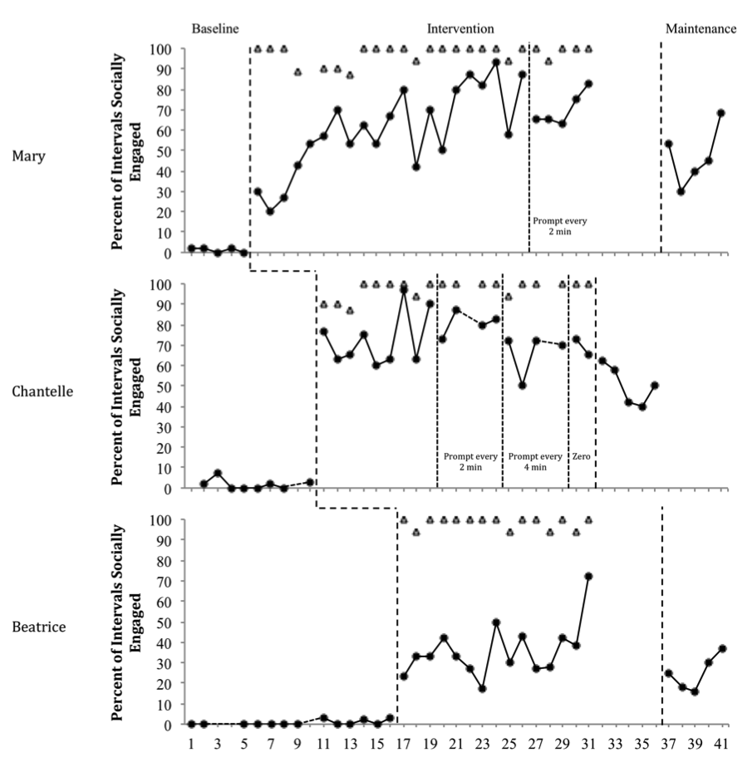
Social Engagement in the Lunchroom
 | M | C | B
 | Baseline
Avg. | 1% | 2% | 1%
 | Intervention
Avg | 62% | 73% | 36%
TI | 98% | 98% | 98%
 | Fading
2 min | 70% | 81% | NA
4 min | NA | 66% | NA
P -- | NA | 69% | NA
 | Maintenance
Avg. | 47% | 50% | 25%

Slide 15
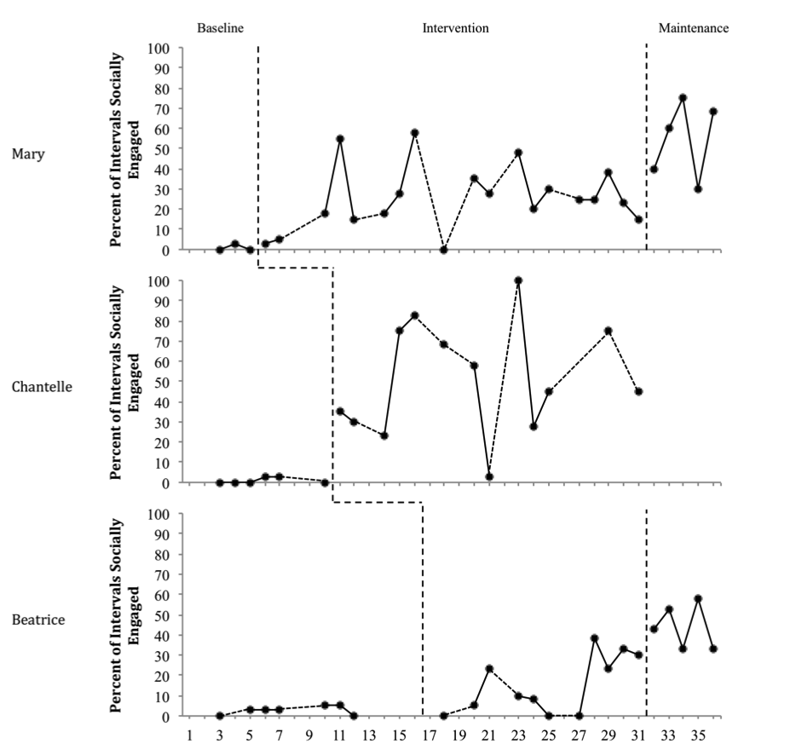
Social Engagement on the Playground
(Generalization)
 | M | C | B
 | Baseline
Avg. | 1% | 1% | 3%
 | Intervention
Avg | 26% | 51% | 15%
 | Maintenance
Avg. | 55% | NA | 44%

Slide 16
Summary of Past Results
Results supported the SMILE technique for students with DD
Intervention results generalized and maintained
Social validity reports were positive

Slide 17
Smile used with students with EBD
Social Mechanics in the Integrated Learning Environment

Slide 18
Purpose
Examine the effectiveness of SMILE on social engagement for young children with EBD
Examine the generalized effects of SMILE Project
Assess maintenance of skills
Evaluate the effects of improved social engagement as addressed in the lunchroom setting on social skills problem behaviors exhibited in other school environments

Slide 19
Participants
Selection
Teacher identification
Displays chronic social interaction deficits
Past requests of additional social supports
Involvement in past social skills interventions in the past with little to no success
Below average Social Skills domain score on SSIS
Dayton
8 years old
EBD
Difficulty maintaining social interactions
Inappropriate during social interactions
Avoided by peers
Exaggerates

Slide 20
Participants
Nathan
9 years old
EBD
Slow speech
Physically awkward
Learning difficulties in all areas
Not allowed to attend lunch/recess due to physical aggression toward peers
Lucas
8 years old
EBD
Severe learning difficulties in reading/writing
Inappropriate with peers
Talks loudly
Chases and hits peers during recess

Slide 21
Social Skills Improvement System
 |  | Dayton | Nathan | Lucas
Social Skills | Standard Score | 74 | 67 | 67
 | Percentile Rank | 5 | 2 | 2
Problem Behavior | Standard Score | 115 | 155 | 75
 | Percentile Rank | 82 | >99 | 6
Academic Competence | Standard Score | 99 | 68 | 73
 | Percentile Rank | 51 | 2 | 5

Slide 22
Setting
Treatment
Generalization

Slide 23
Variables
Dependent
Independent
Appropriate Social Engagement
Communicating in an appropriate manner
Following rules
Sharing
Listening
Turn-taking
Helping
Cooperation
SMILE Intervention
Social skills lessons
Brief during transition to lunch
Prompting
1 minute intervals
Fading
4 days at 50% or higher

Slide 24
Design and Data Collection
Multiple probe design
Phases
Baseline
Intervention
Maintenance
Beginning of fall semester
Generalization
Playground
Data collection
20 minute sessions
15-second momentary time sampling for social engagement
IOA
Social Engagement
Treatment Integrity

Slide 25
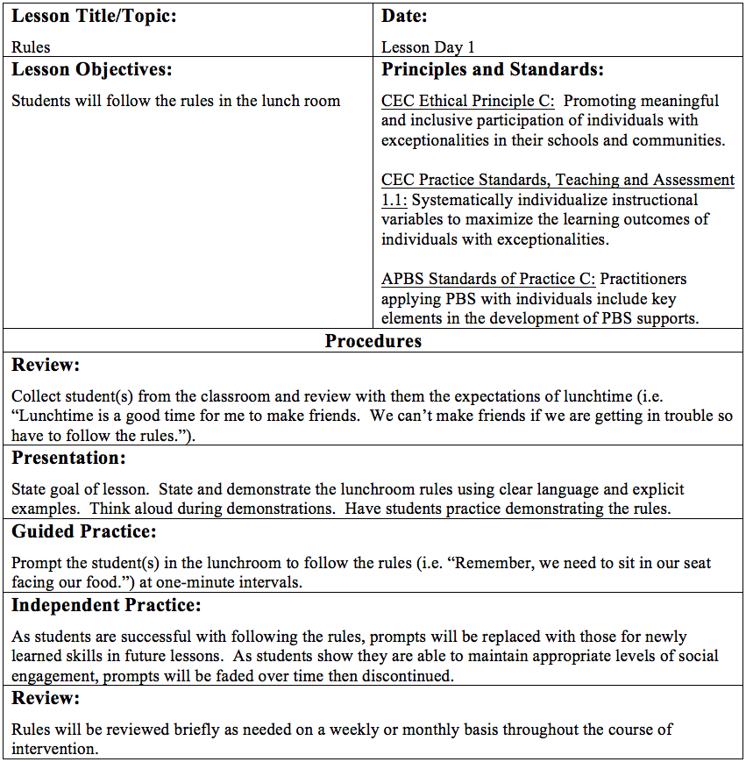
Day 1 of SMILE
Introduction to intervention
Lesson: Rules
I do
We do
You do
Re-review:

Slide 26
Subsequent Sessions
Lessons
Prompting
Body language
Vocal tone
Conversation topics
Responding to peers
Sharing
Helping
Occurs every minute
Prompts related to current or past lessons
Prompt to contribute something to ongoing discussion or begin new conversation
Fading
50% or better for 3 consecutive sessions
2 minute
4 minute
Discontinue

Slide 27
Reinforcement
Friend Paper
Motivation for typically developing peers to engage with participant (Hendricson, Strain, Tremblay, & Shores, 1982)
Peer placed sticker on “Friend Paper” when participant is socially engaged
Fading
Faded alongside prompting
Peers receive sticker from participant until 4 minute prompting phase
When prompts are delivered at 2 minute intervals, friend paper is discontinued

Slide 28
Results

Slide 29
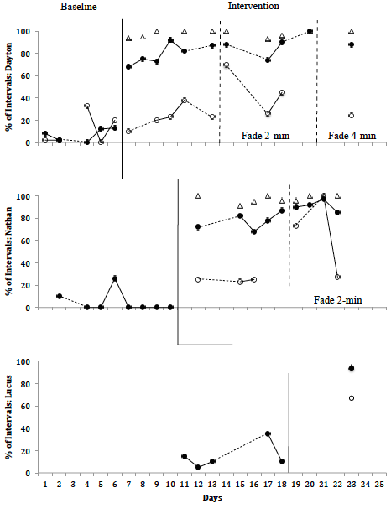
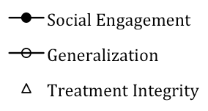
Nathan
Social Engagement: Lunch
Baseline: 5%
Intervention: 77%
Fade 2-min: 91%
Fade 4-min: ------
Social Engagement: Recess
Baseline: ------
Intervention: 24%
Fade 2-min: 67%
Fade 4-min: ------
Dayton
Social Engagement: Lunch
Baseline: 7%
Intervention: 80%
Fade 2-min: 88%
Fade 4-min: 88%
Social Engagement: Recess
Baseline: 11%
Intervention: 23%
Fade 2-min: 47%
Fade 4-min: 24%
Lucas
Social Engagement: Lunch
Baseline: 15%
Intervention: 94%
Fade 2-min: ------
Fade 4-min: ------
Social Engagement: Recess
Baseline: 33%
Intervention: 67%
Fade 2-min: ------
Fade 4-min: ------

Slide 30
Summary
Initial results support use of SMILE Project with students with EBD
Initial results show skills generalize to novel settings
Maintenance results are promising according to Stokes & Baer (1977)
Initial anecdotal reports of social validity
Limitations
Lack of classroom data
Conducted with young children
Teacher buy-in
Future Research
Effect on problem behavior
Effect with older students
Generalization to special classes and extracurricular activities
Paraprofessional training

Slide 31
References
Archer, A.L., & Hughes, C.A. (2010). Explicit instruction. Effective and efficient teaching. New York, NY: The Guilford Press.
Ault, M.J., & Griffen, A.K. (2013). Teaching with system of least prompts: An easy method for monitoring progress. Teaching Exceptional Children, 45(3), 46-53.
Battalio, R., & Stephens, J.T. (2005). Social skills training: Teacher practices and perceptions. Beyond Behavior, 14(2), 15-20.
Blood, E., Johnson, J., Ridenour, L., Simmons, K., & Couch, S. (2011). Using an iPod Touch to teach social and self-management skills to an elementary student with emotional/behavioral disorders. Education and Treatment of Children, 34(2), 299-317.
Craig-Unkefer, L.A., & Kaiser, A.P. (2002). Improving the social communication skills of at-risk preschool children in a play context. Topics in Early Childhood Special Education, 22, 3-13.

Slide 32
References
Daunic, A., Corbett, N., Smith, S., Barnes, T., Santiago-Poventud, L., Chalfant, P., Pitts, D., & Gleaton, J. (2013). Brief report: Integrating social-emotional learning with literacy instruction: An intervention for children at risk for emotional behavior disorders. Behavior Disorders, 39(1), 43-51.
Demchak, M. (1990). Response prompting and fading methods: A review. American Journal on Mental Retardation, 94(6), 603-615.
Donnellan, A.M., LaVigna, G.W., Negri-Shoultz, N.N., & Fassbender, L.L. (1988). Progress without punishment: Effective approaches for learners with behavior problems. New York, NY: Teachers College Press.
Duran, J.B., Zhou, Q., Frew. L.A., Kwok, O., & Benz, M.R. (2013). Disciplinary exclusion and students with disabilities: The mediating role of social skills. Journal of Disability Policy Studies, 24, 15-26.

Slide 33
References
Elliott, S. N., & Gresham, F. M. (1993). Social skills interventions for children. Behavior modification, 17(3), 287-313.
Hansen, S. D., & Linugaris/Kraft, B. (2005). Effects of a dependent group contingency on the verbal interactions of middle school students with emotional disturbance. Behavioral Disorders, 30, 170–184.
Humphreys, T., Polick, A., Howk, L., Thaxton, J., & Ivancic, A. (2013). An evaluation of repeating the discriminative stimulus when using least-to-most prompting to teach intraverbal behavior to children with autism. Journal of Applied Behavior Analysis, 46(2), 534-538.
Kern, L., Starosta, K. M., Cook, C. R., Bambara, L. M., & Gresham, F. R. (2007). Functional assessment-based intervention for selective mutism. Behavioral Disorders, 32, 94–108.

Slide 34
References
Kern, L., Wacker, D.P., Mace, F.C., Falk, G.D., Dunlap, G., & Kromrey, J.D. (1995). Improving the peer interactions of students with emotional and behavioral disorders through self-evaluation procedures: A component analysis and group application. Journal of Applied Behavior Analysis, 28, 47–59.
Kern-Dunlap, L., Dunlap, G., Clarke, S., Childs, K.E., White, R. L., & Stewart, M.P. (1992). Effects of a videotape feedback package on the peer interactions of children with serious behavioral and emotional challenges. Journal of Applied Behavior Analysis, 25, 355–364.
Lane, K.L., Carter, E.W., Pierson, M.R., & Glaeser, B.C. (2006). Academic, social, and behavioral characteristics of high school students with emotional disturbances or learning disabilities. Journal of Emotional and Behavioral Disorders, 14, 108–117.

Slide 35
References
Malecki, C.K., & Elliot, S.N. (2002). Children's social behaviors as predictors of academic achievement: A longitudinal analysis. School Psychology Quarterly, 17(1), 1-23.
Malmgren, K., Edgar, E., & Neel, R.S. (1998). Postschool status of youths with behavioral disorders. Behavioral Disorders, 23(4), 257-63.
Mathur, S.R., Kavale, K.A., Quinn, M.M., Forness, S.R., & Rutherford Jr, R.B. (1998). Social skills interventions with students with emotional and behavioral problems: A quantitative synthesis of single-subject research. Behavioral Disorders.
Moore, R.J., Cartledge, G., & Heckaman, K. (1995). The effects of social skill instruction and self-monitoring on game-related behaviors of adolescents with emotional or behavioral disorders. Behavioral Disorders, 20, 253–266.

Slide 36
References
Presley, J.A., & Hughes, C. (2000). Peers as teachers of anger management to high school students with behavioral disorders. Behavioral Disorders, 25, 114–130.
Sarokoff, R.A., Taylor, M.A., & Poulson, C.L. (2001). Teaching children with autism to engage in conversational exchanges: Script fading with embedded textual stimuli. Journal of Applied Behavior Analysis, 34(1), 81-84.
Sigman, M., & Ruskin, E. (1999). Continuity and change in the social competence of children with autism, downs syndrome, and developmental delays. Monographs of the Society for Research in Child Development, 64(1, Serial No. 256).
Sturmey, P. (1997). Introductory remarks: Long-term follow-up of behavioral interventions for challenging behaviors in persons with developmental disabilities. Behavioral Interventions, 12(4), 157-162.

Slide 37
References
Thomas, B.R., Lafasakis, M., & Sturmey, P. (2010). The effects of prompting, fading, and differential reinforcement on vocal mands in non-verbal preschool children with autism spectrum disorders. Behavioral Interventions, 25(2), 157-168.
Wagner, M., Newman, L., Cameto, R., Levine, P., & Garza, N. (2006). An overview of findings from wave 2 of the National Longitudinal Transition Study-2 (NLTS2). NCSER 2006-3004. National Center for Special Education Research.

Slide 38
Explicit Instruction
Review
Review relevant previous learning
Review prerequisite skills and knowledge
Presentation
State lesson goals
Present new material in small steps
Model procedures
Use clear language
Avoid digressions
Guided practice
Require high frequency of responses
Ensure high rates of success
Provide timely feedback, clues, and prompts
Have students continue practice until they are fluent
Corrections and feedback
Independent practice
Monitor initial practice attempts
Have students continue practice until skills are automatic
Weekly and monthly review
(Archer & Hughes, 2011, p. 4)

